Slide 1
Aspire, Collaborate, Engage
Notes:
The West London Partnership exists to allow us to find commonality with students from other schools or backgrounds.
Aspirations, curiosity, social anxiety, worries about barriers to a successful future or even lacking self-belief are shared obstacles that young people face.
Partnerships support connectedness - students and staff across all sectors, both state and independent - ensuring that everyone is given the opportunity to collaborate on meaningful projects.

Slide 2
Cardinal Vaughan Memorial School
Notes:
The West London Partnership is an association of secondary schools from both the independent and state sectors in West and South West London.
We aim to create a genuine partnership built on sustainable, collaborative projects where schools and other institutions work together, sharing resources and expertise, to address educational needs and to enrich learning for everyone.

Slide 3
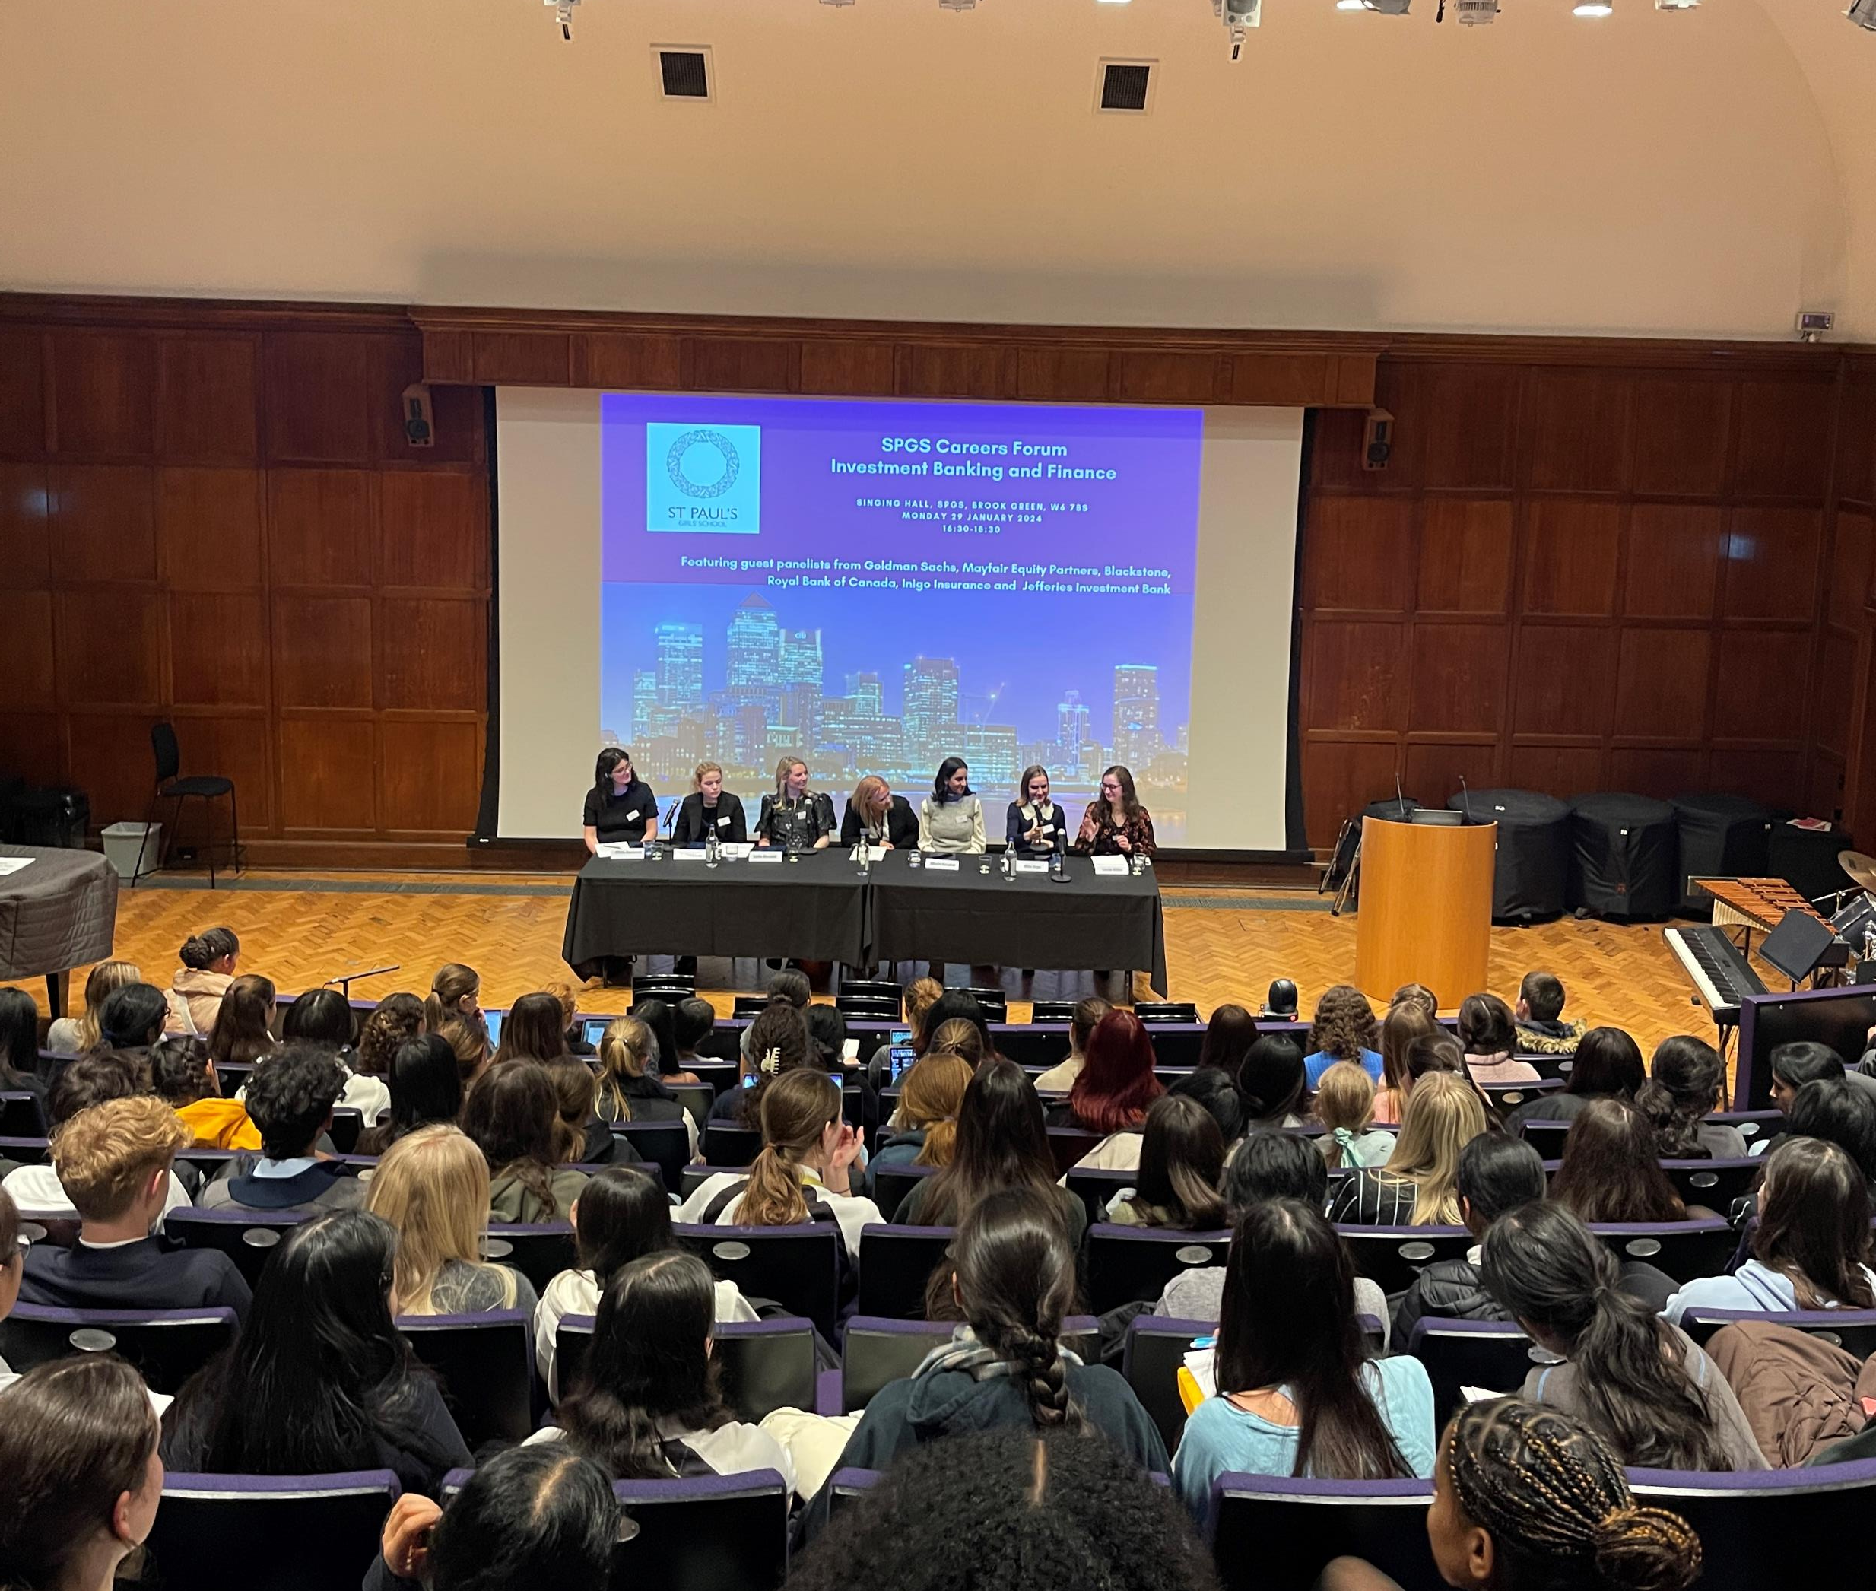
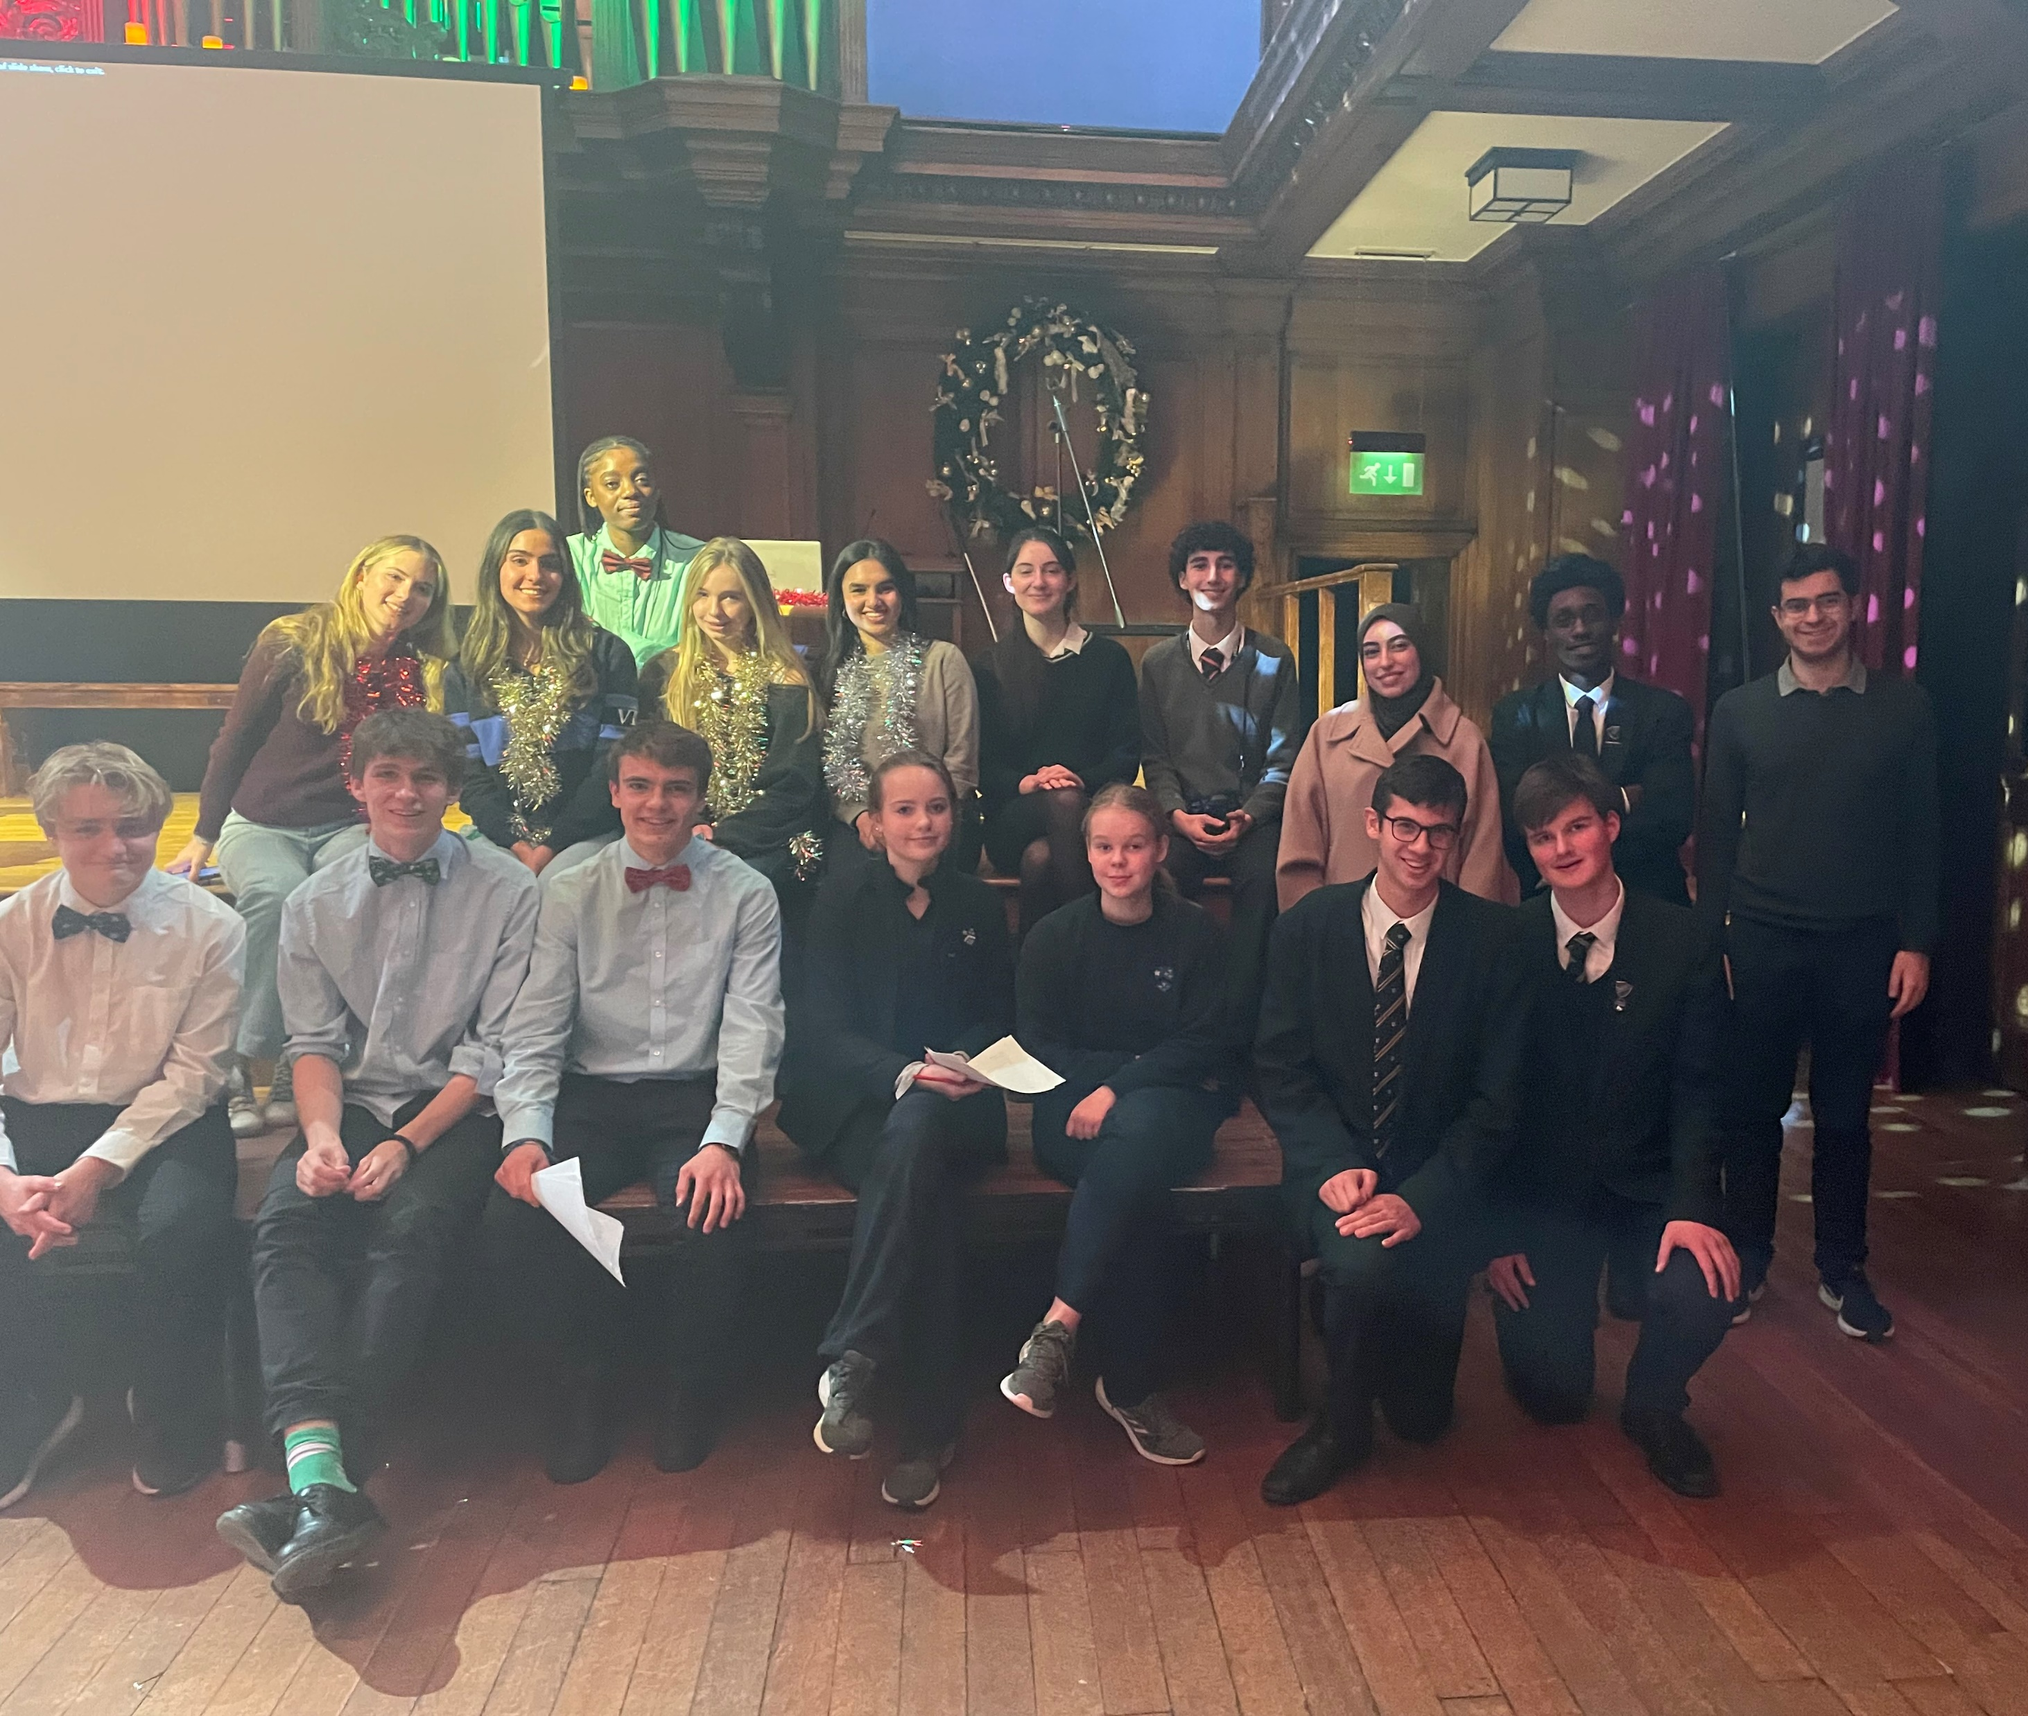
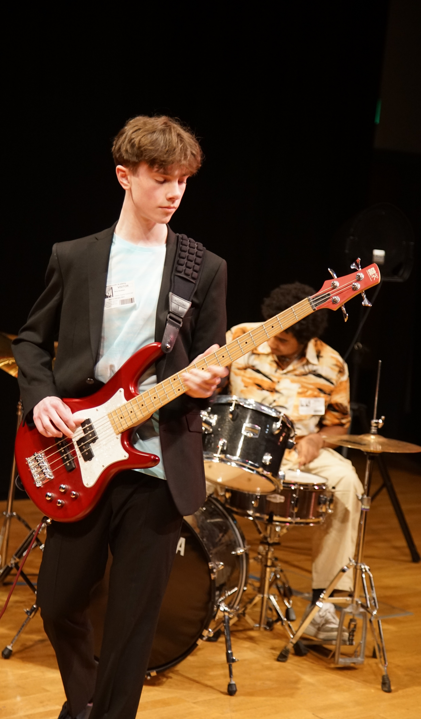
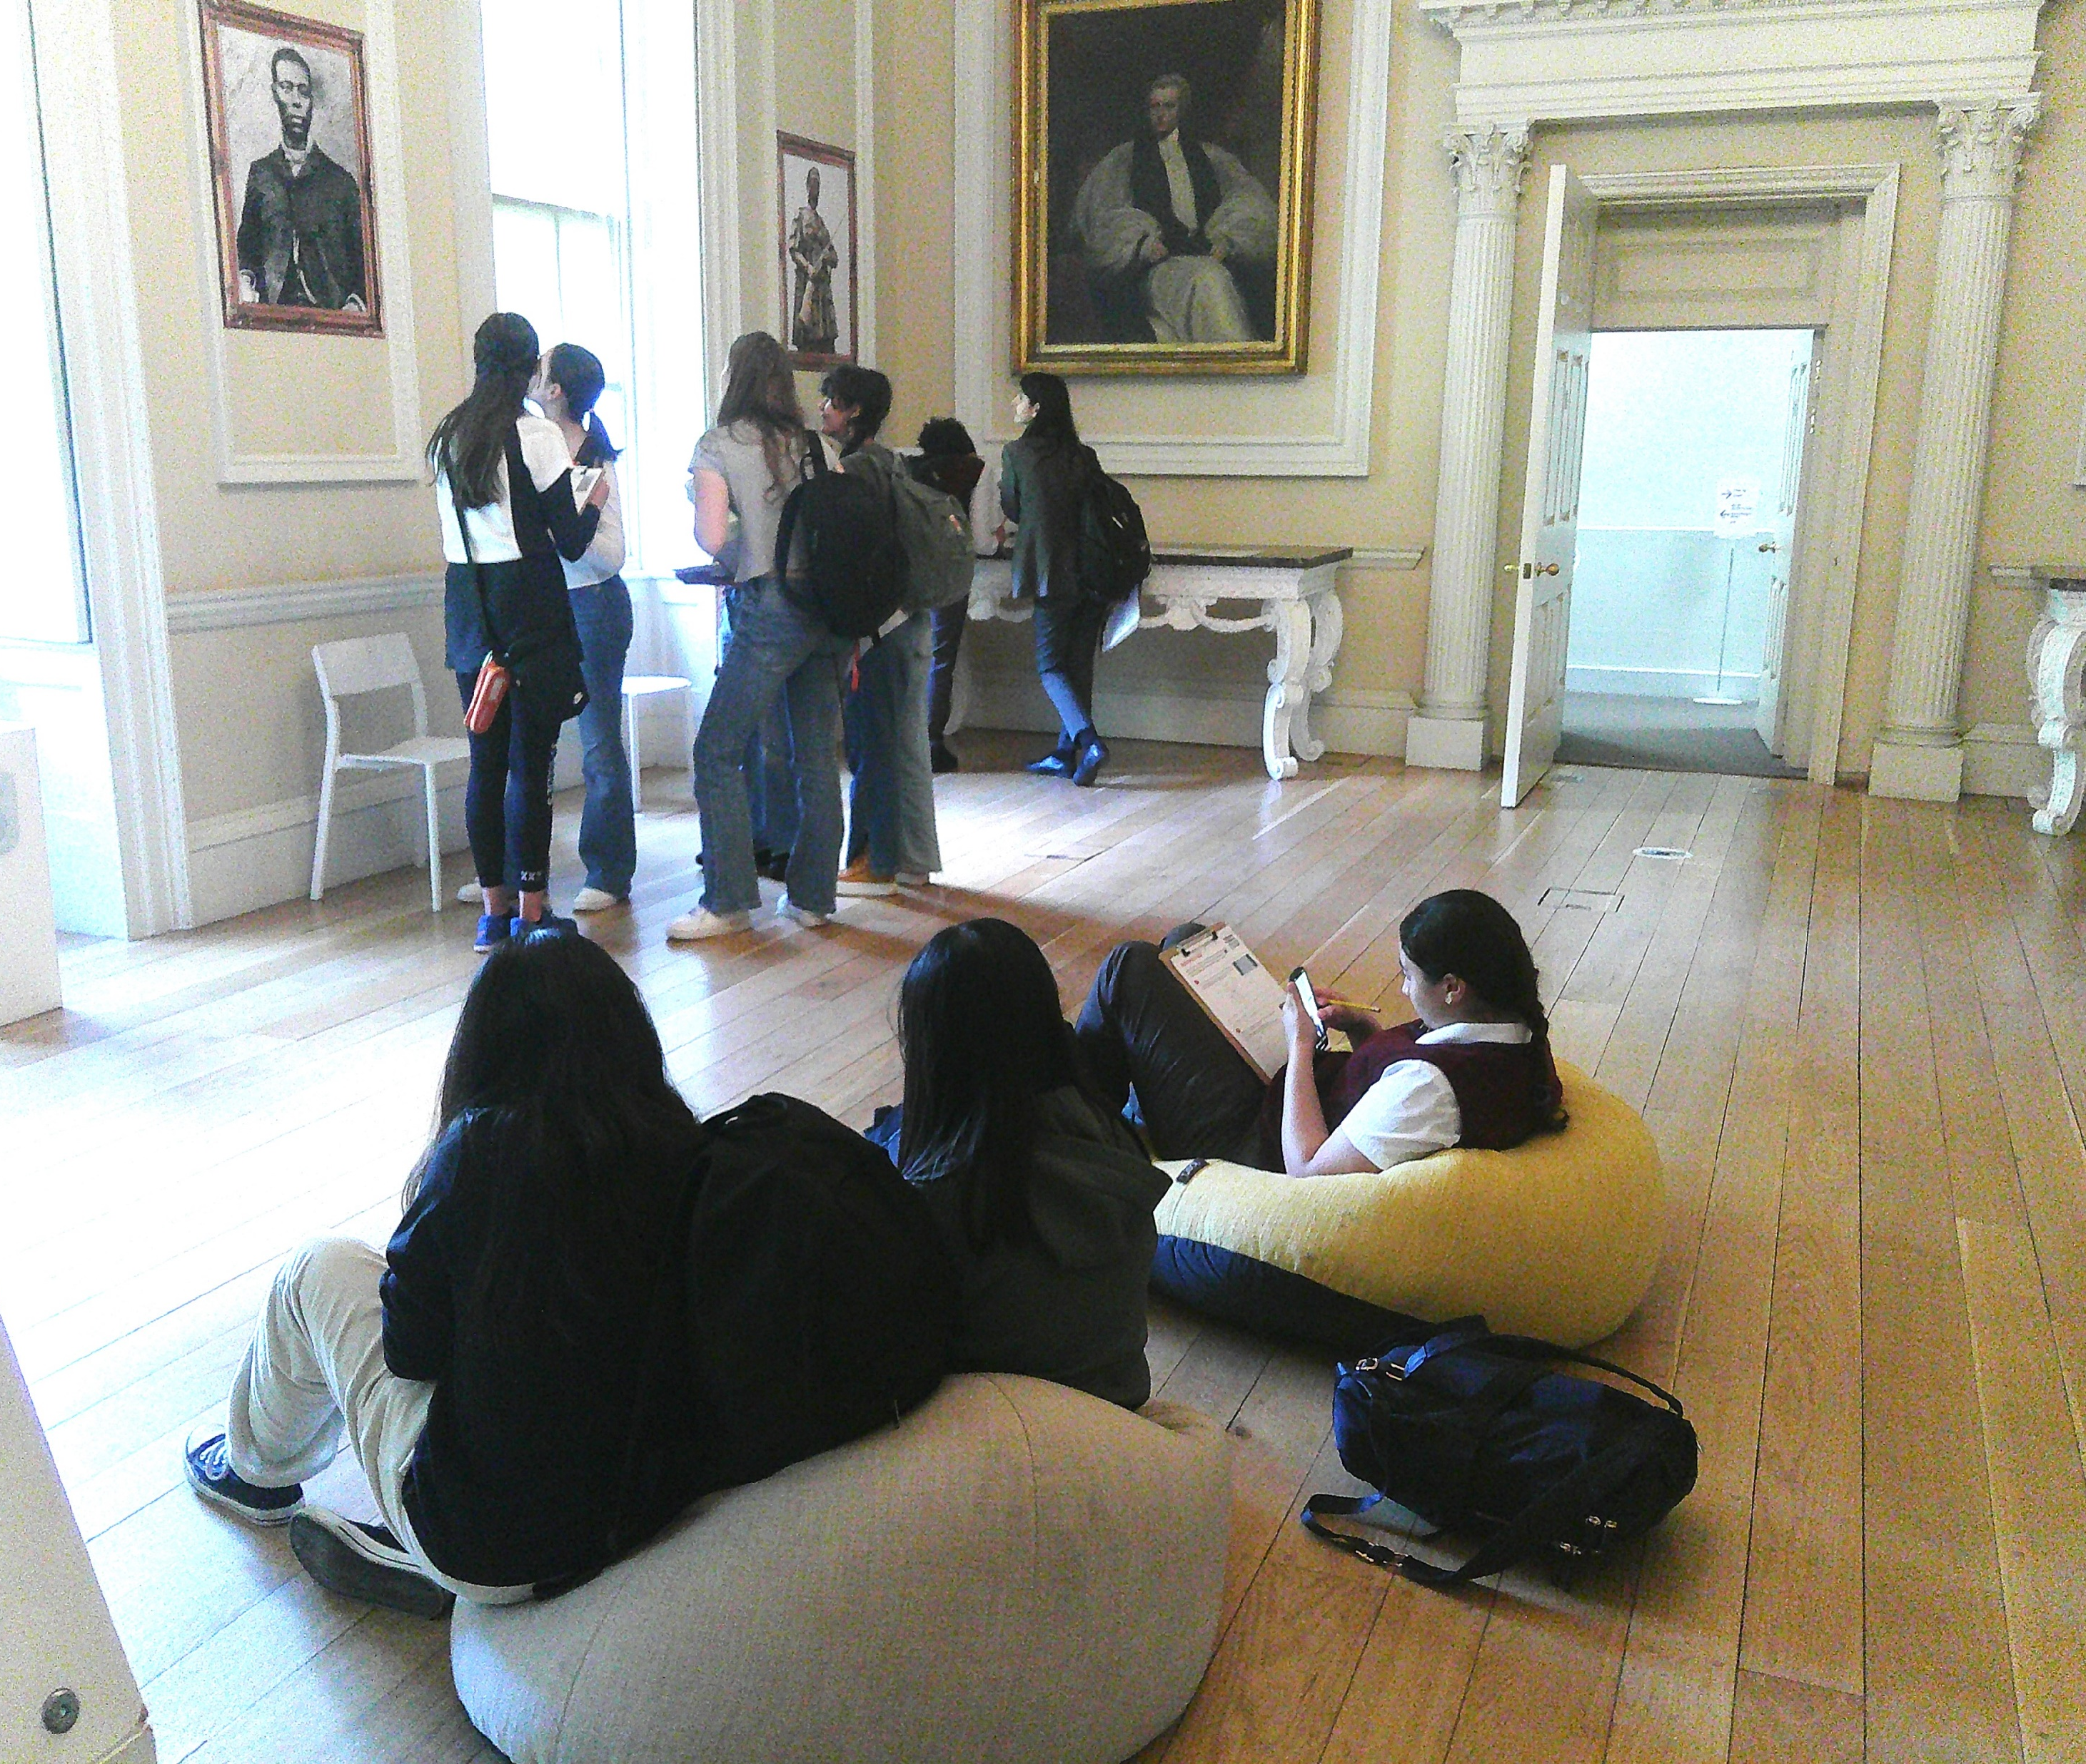
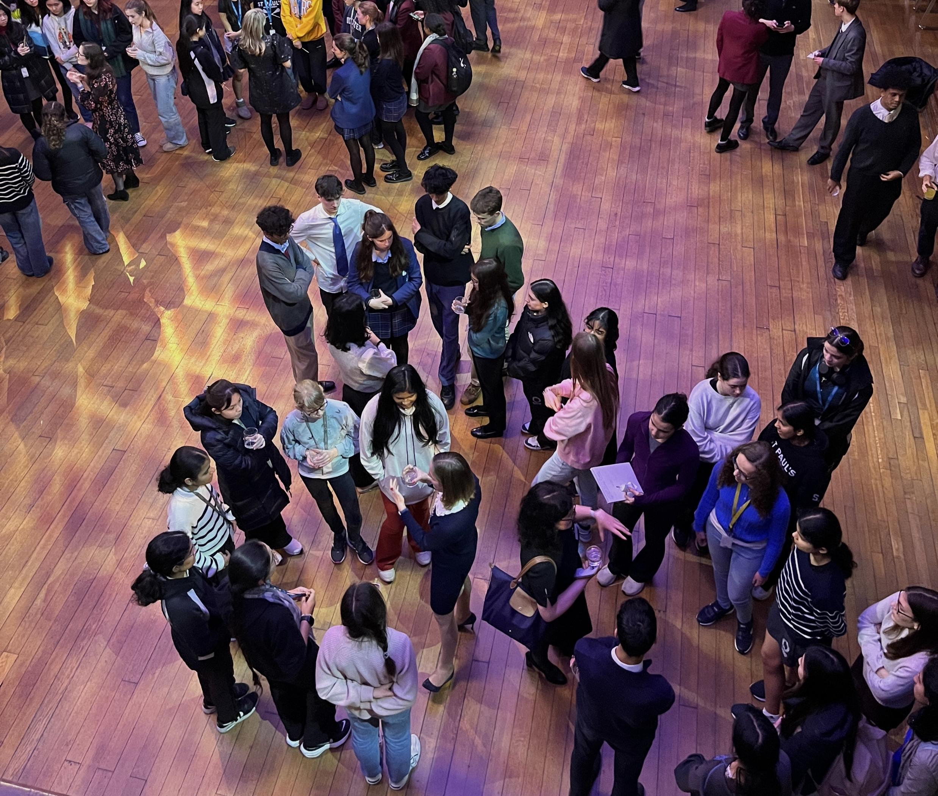
Collaborating
Joint lectures
Workshops
Networking
Notes:
The West London Partnership stands out for its diverse range of engaging events.
In March 2023 Battle of the Bands captivated staff and students with a celebration of musical talent, creating an electric atmosphere for both participants and spectators.
The annual Christmas Student Quiz, for Year 9s, encourages friendly competition among students.
Complementing these lively gatherings each school delivers a range of academic & careers events.

Slide 4
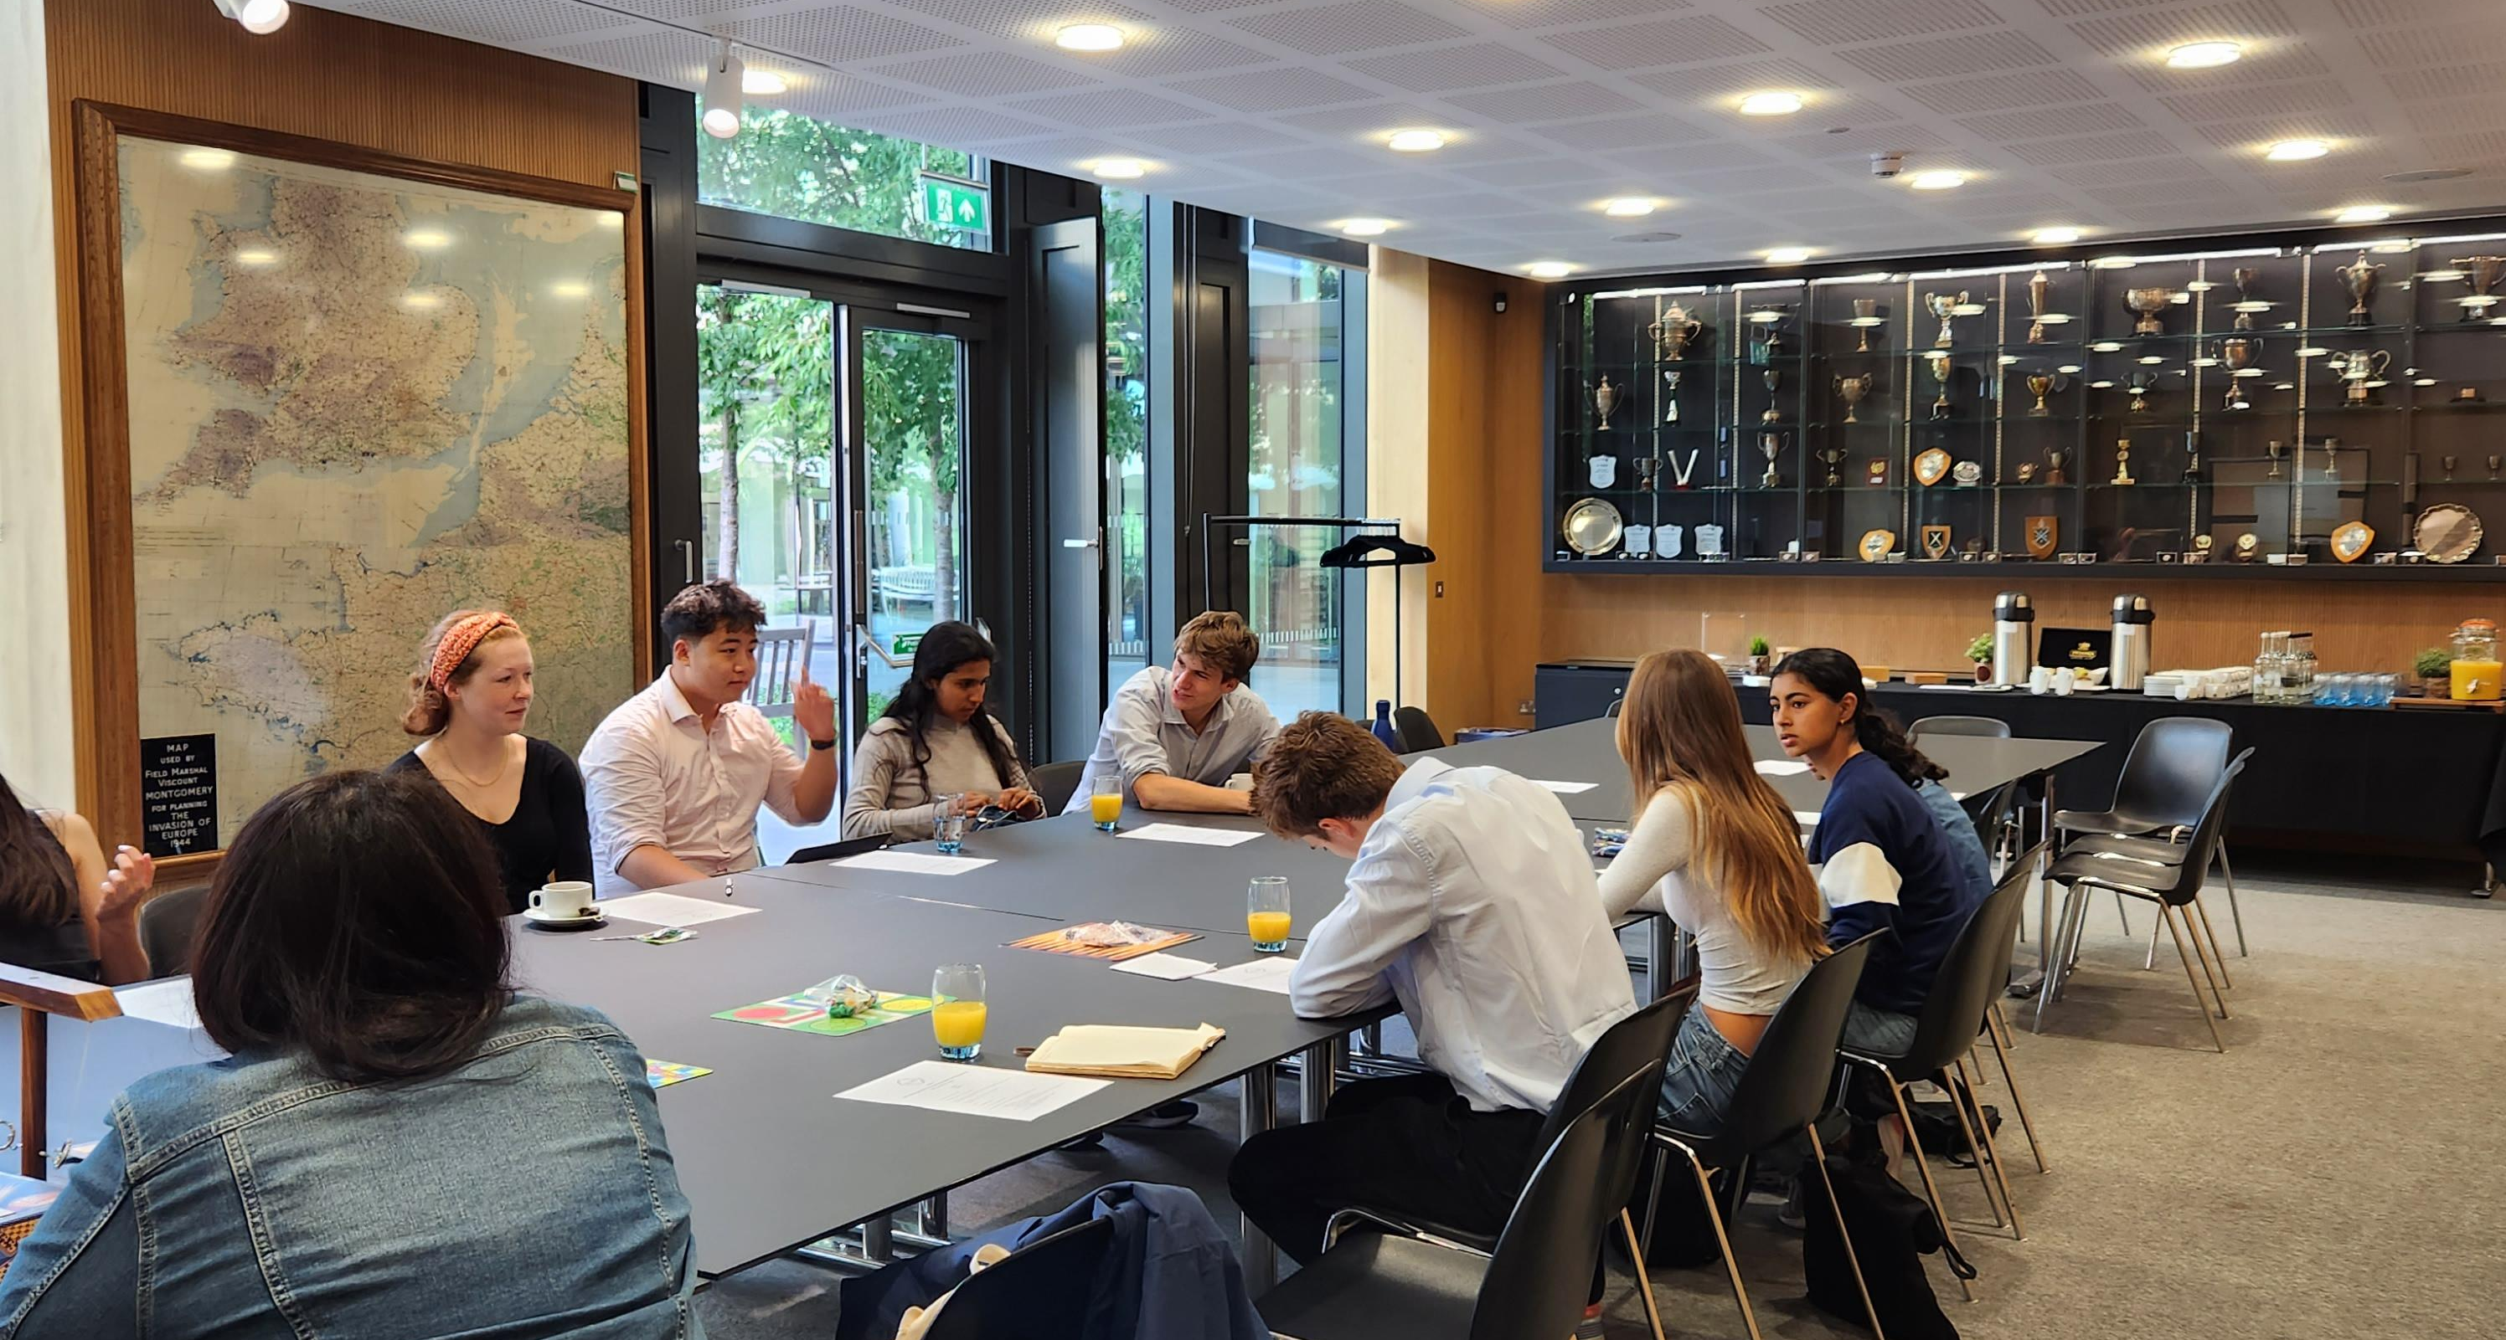
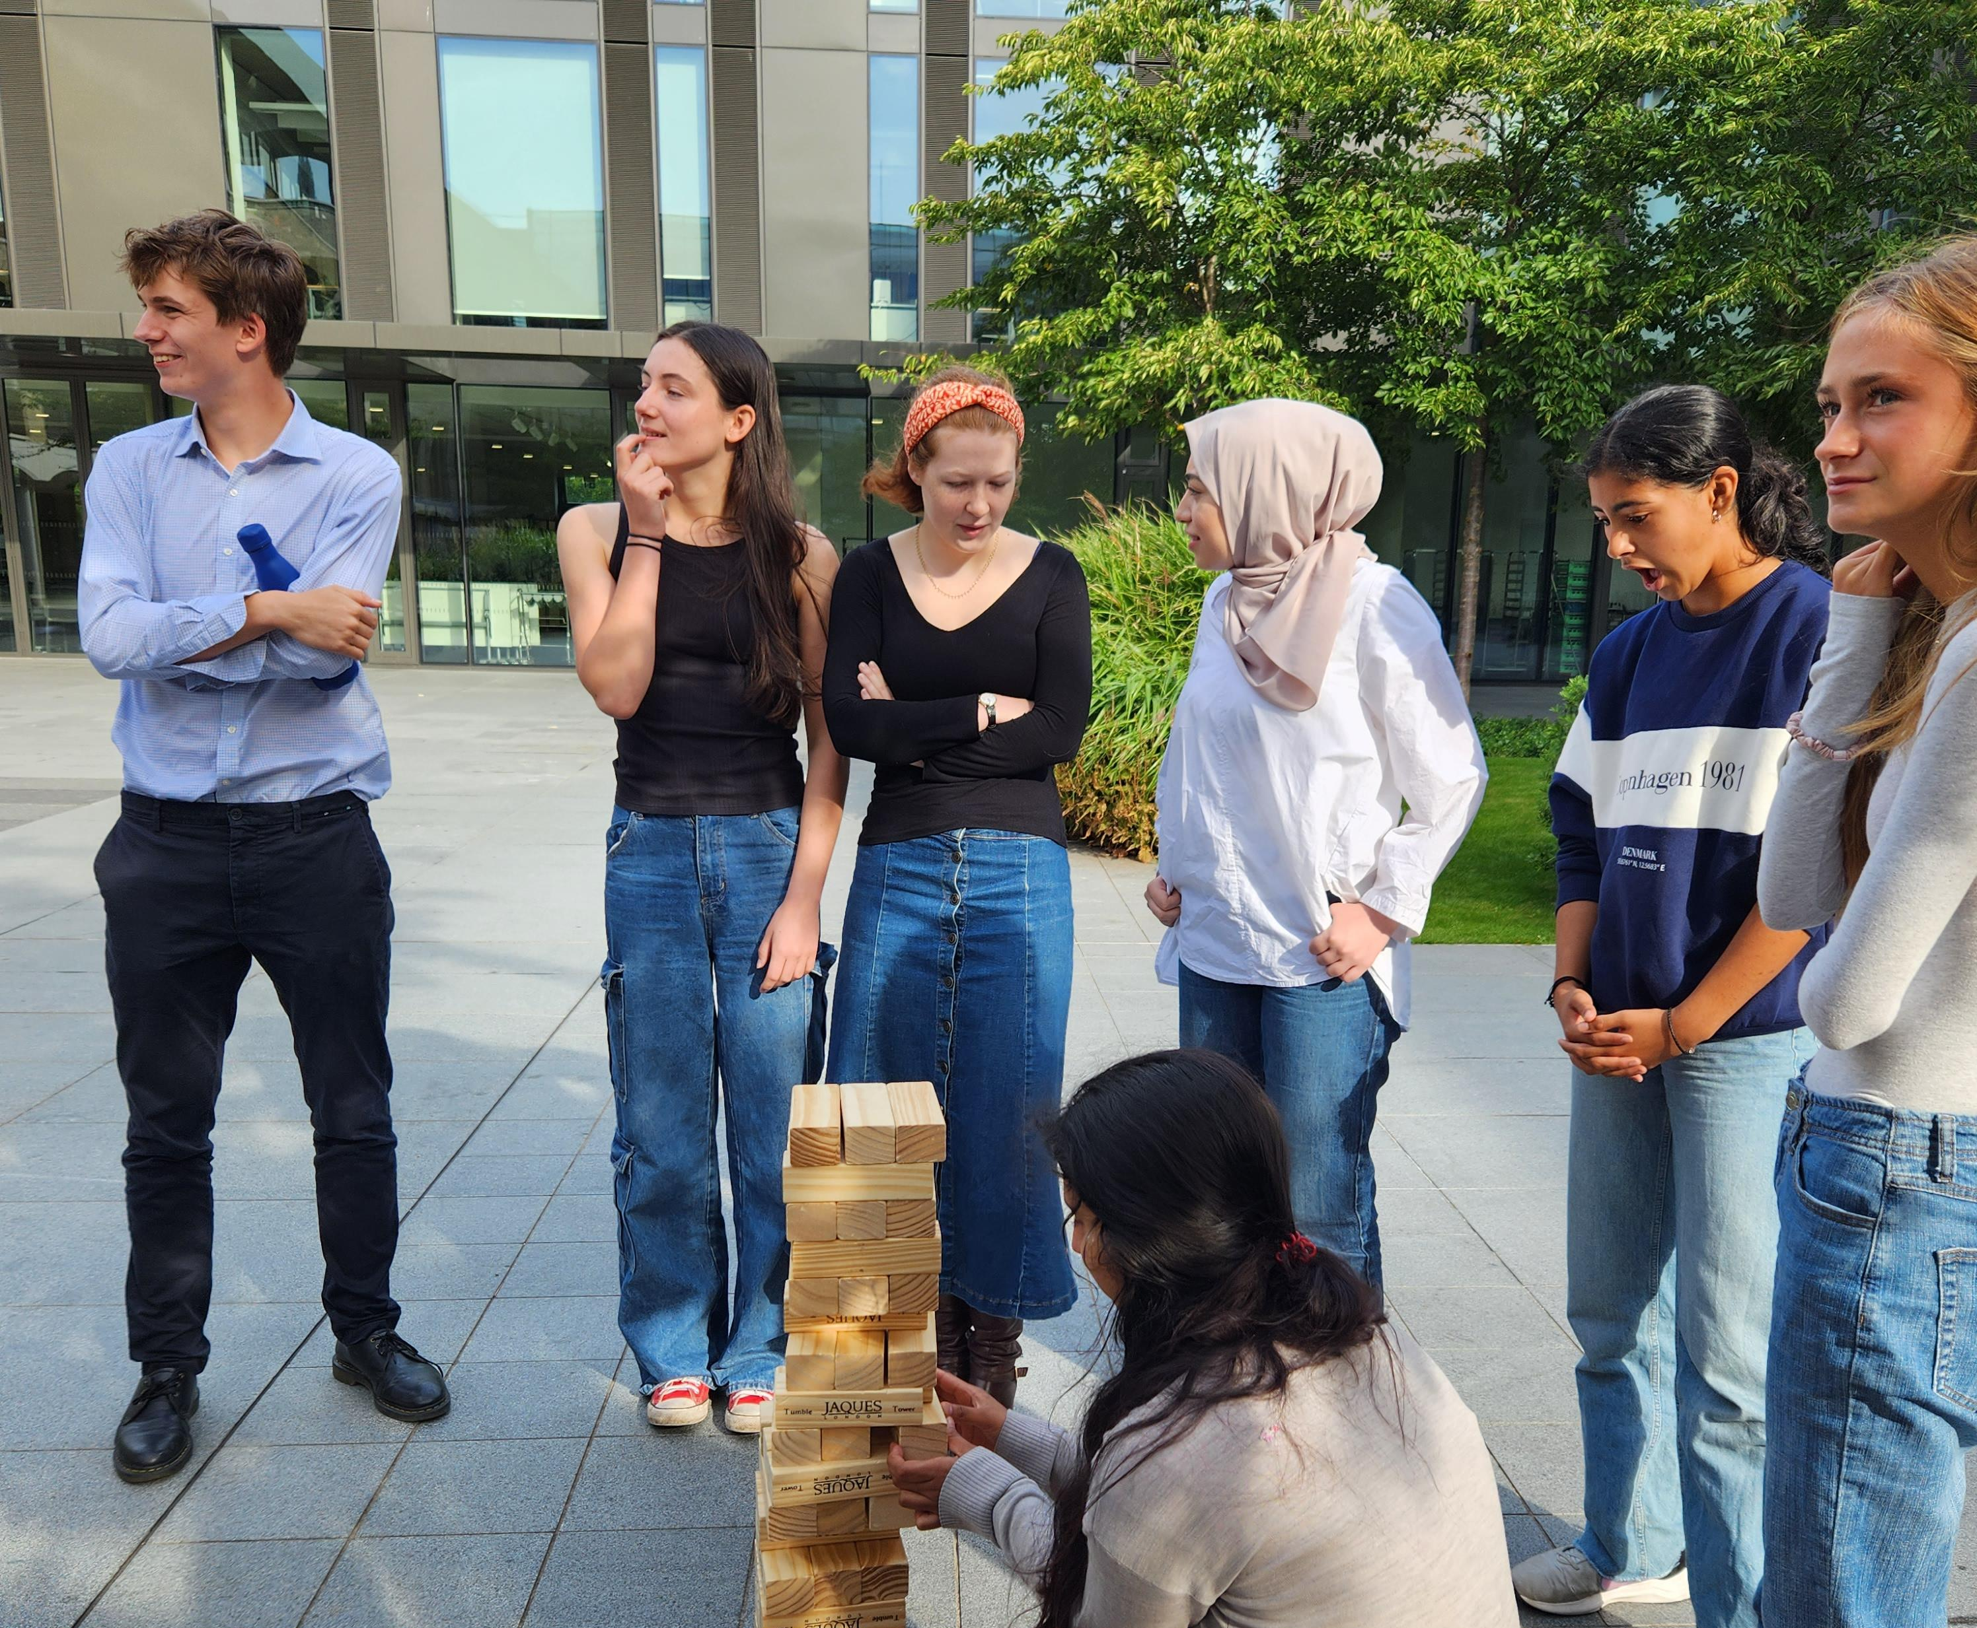
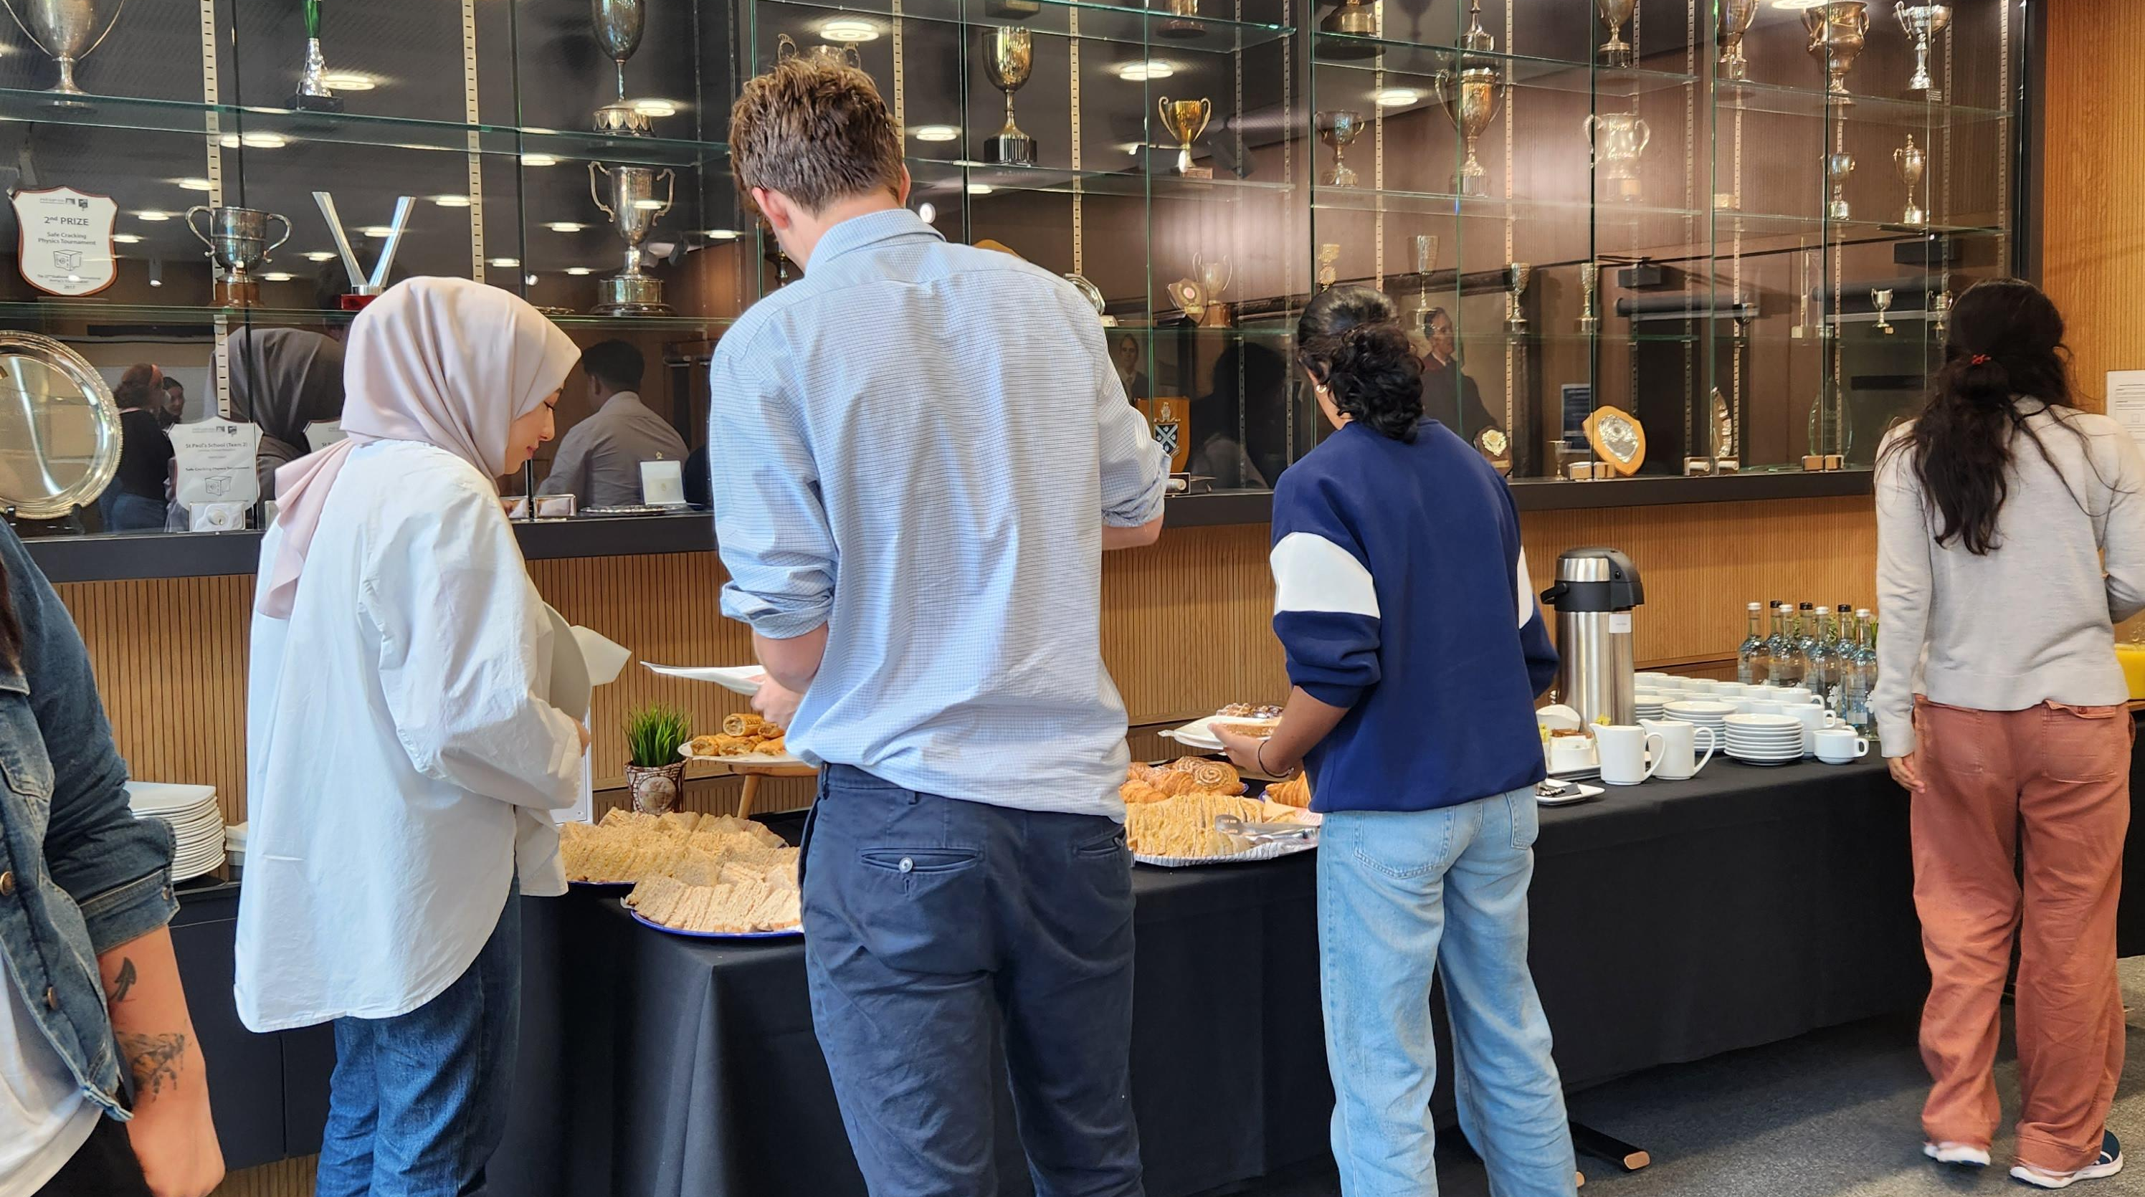
Notes:
The student committee attend bi-termly meetings to discuss and shape the West London Partnership.
Regular participation in these gatherings provides a platform to exchange ideas, address challenges, and collectively contribute to the partnership’s growth.
Organizing events is a dynamic aspect of the role, fostering a sense of community and empowerment within the student body.
This term we are looking for new members to join us, if you would like the opportunity to gain skills in leadership and teamwork and contribute to the WLP please get in touch.

